Slide 1

FoodieHub Application
Final Project : CSYE6200 Prof. Jones Yu Team name: Dynamic Debuggers Joseph Joshi Aerrolla(NUID : 002848629) Aruna Senthamaraikannan(NUID : 002082635) Harsha Vardhan Reddy Kallem(NUID : 002379909)

Slide 2

Problem Description
Limited Ingredients:
Cultural and Culinary Challenges:
International students and working professionals often have minimal and limited ingredient supplies.
Difficulties adapting to local cuisines push users to rely on familiar, restricted ingredients.
Platform Shortcomings:
Need for Personalization:
Existing recipe platforms assume a fully stocked kitchen.
A system that suggests recipes based on available ingredients.
They provide generic suggestions and lack personal recipe management features.
Helps minimize food waste and caters to individual needs.

Slide 3

Analysis
User Insight
Time & Budget Constraints
Platform Gaps
Students want ingredient-based recipes due to unfamiliarity with local cuisines.
Current platforms lack ingredient-focused search and personal recipe management.
Professionals need quick, affordable meals.
Existing platforms don't address limited ingredient access, highlighting the need for personalization. FoodieHub offers a unique solution for international students and professionals with ingredient-based recipes and personalization.

Slide 4



Design
Frontend: JavaFX
Rich GUI built with JavaFX, utilizing FXML for declarative UI design.
Backend: Java
Java backend leveraging JDBC for persistent data storage and retrieval from SQLite.
Spoonacular API
External API integration for expanded recipe options and nutritional information.
The system follows the MVC pattern to decouple the UI from the application logic. The frontend is constructed using JavaFX and FXML for a modern user interface. The backend is implemented in Java, employing JDBC for seamless interaction with the SQLite database.

Slide 5
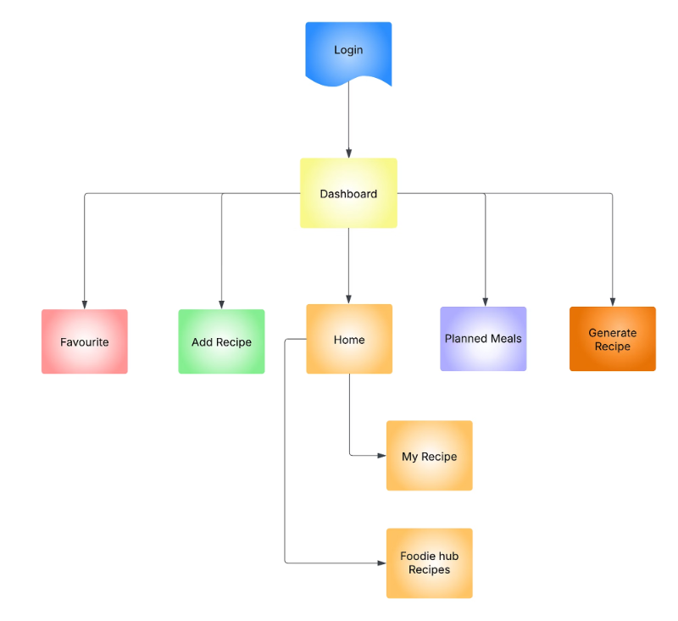
Flow Chart

Slide 6




Key Implementation Details
Dynamic List Generation
Recipe Publishing
Favorites Management
Adjustable Serving Sizes
Efficiently manage and update recipe lists based on user input and API data.
Allow users to contribute their own recipes and share them with the community.
Enable users to save and organize their preferred recipes for quick access.
Automatically scale ingredient quantities based on the desired number of servings.
The frontend utilizes JavaFX with FXML for a responsive user interface. The backend ensures persistent data storage and retrieval by connecting to SQLite via Java with JDBC. Furthermore, the Spoonacular API enriches the application by providing a wide array of ingredient-based recipe suggestions.

Slide 7
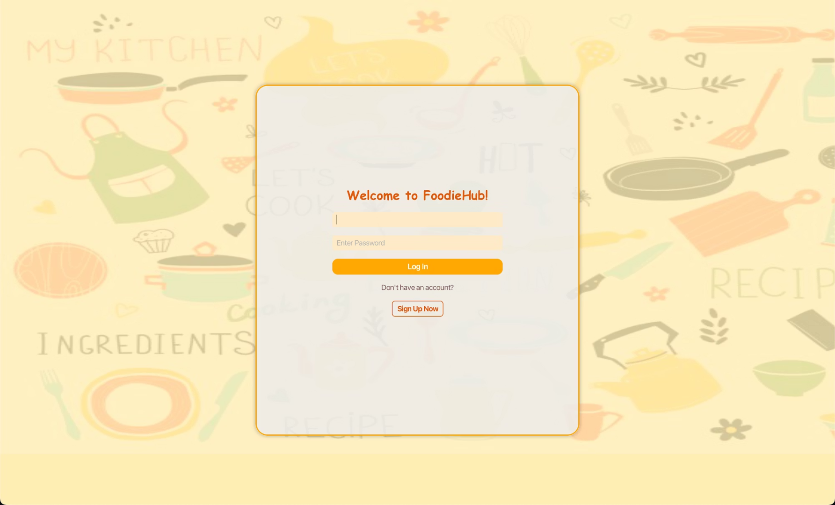
Login

Slide 8
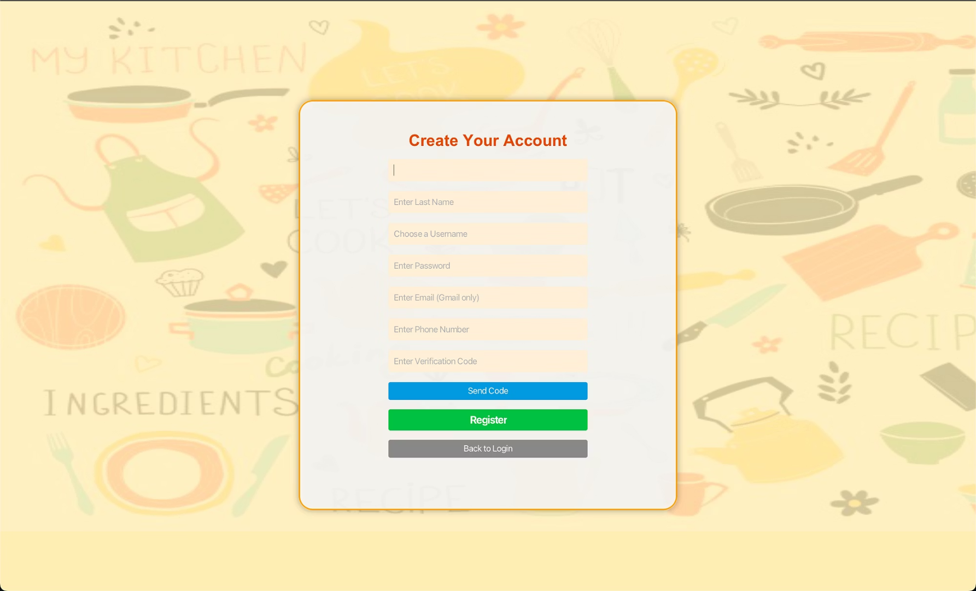
Signup

Slide 9
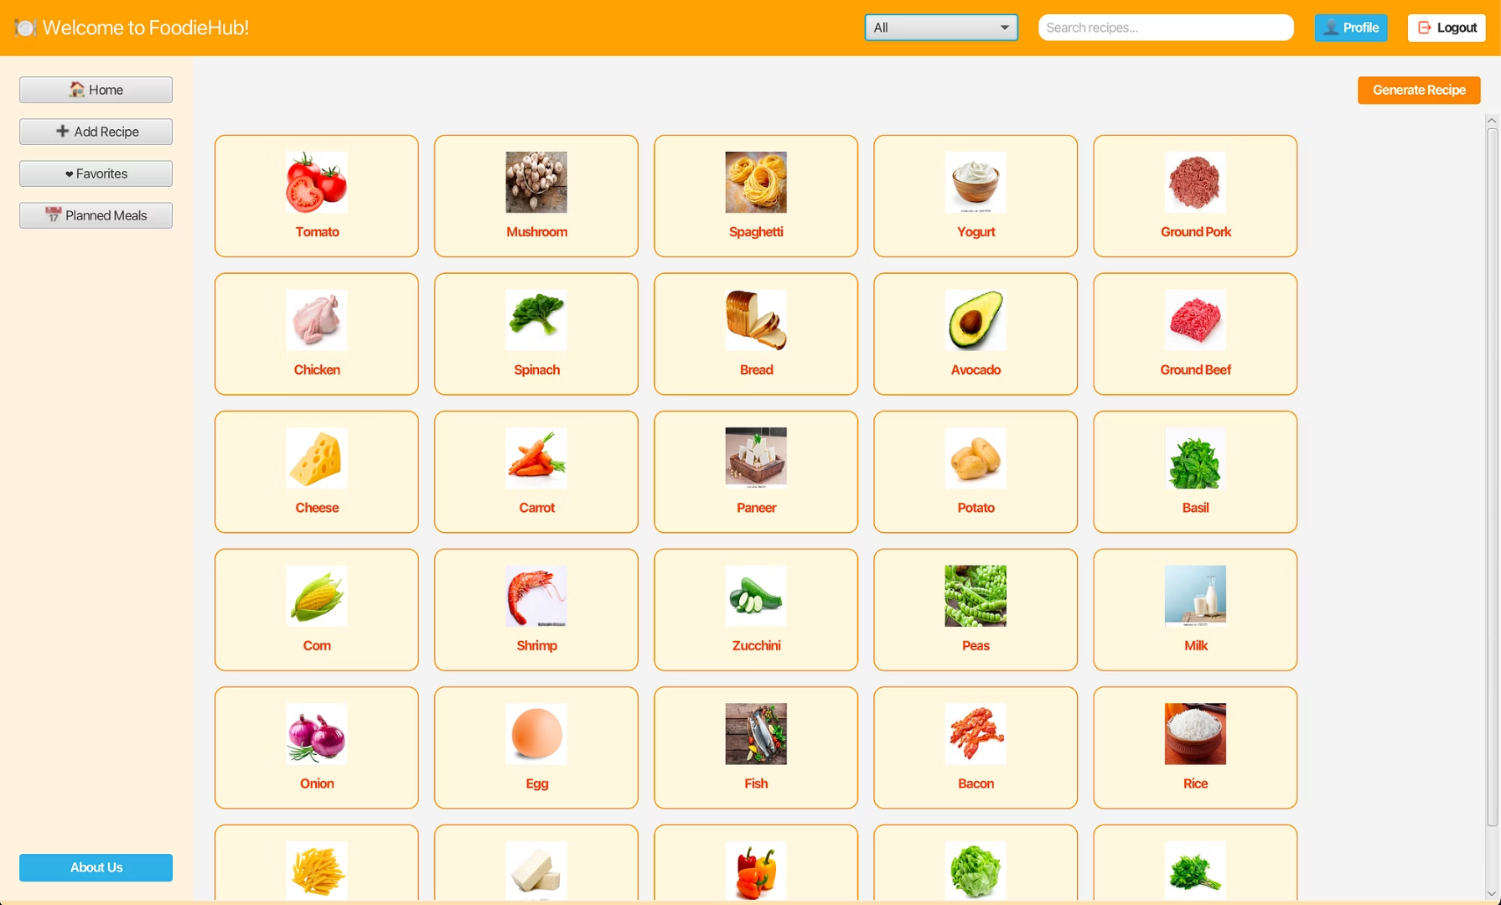
Dashboard

Slide 10
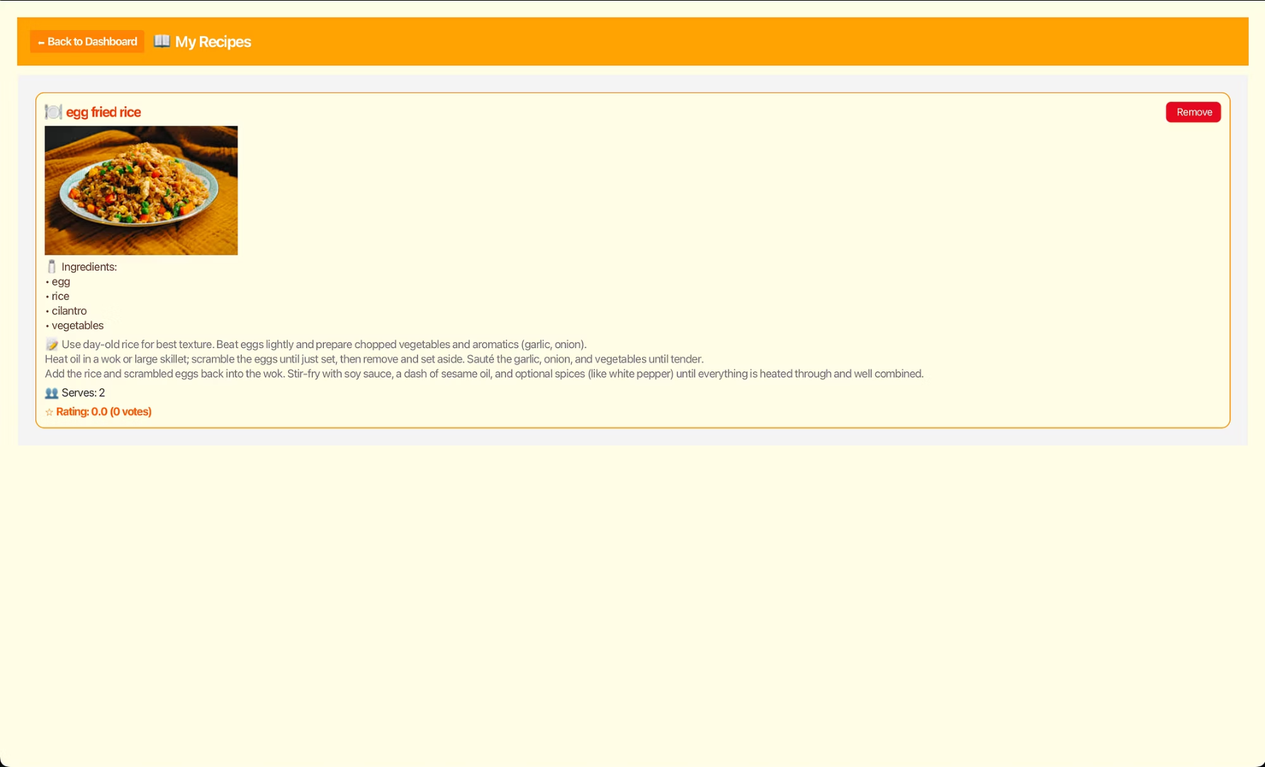
My Recipes

Slide 11
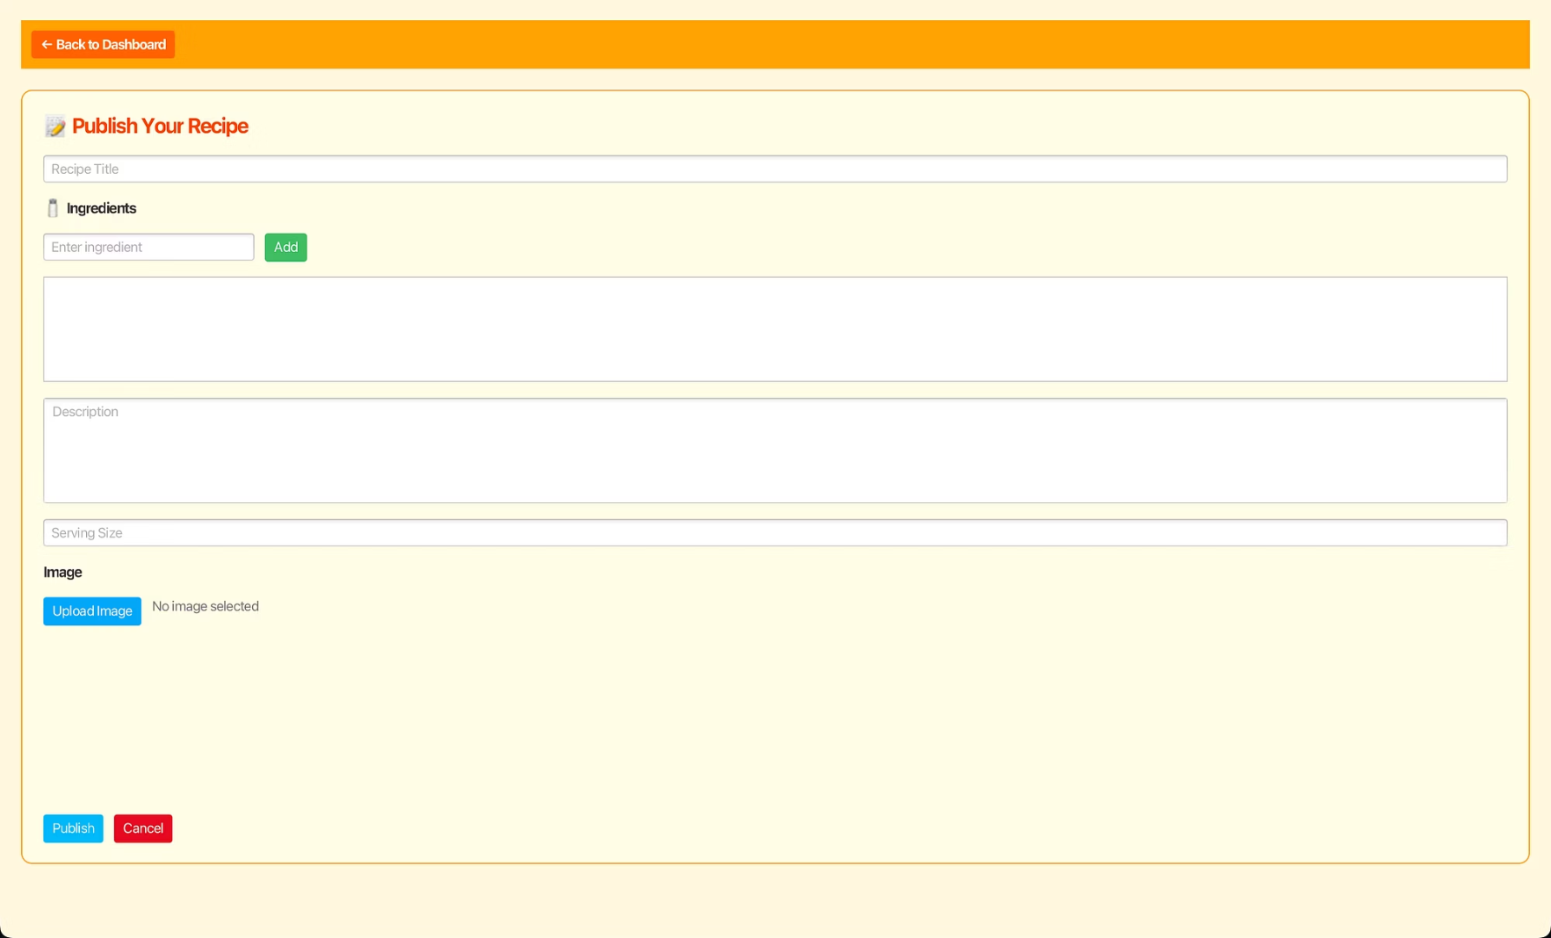
Publish Recipe

Slide 12
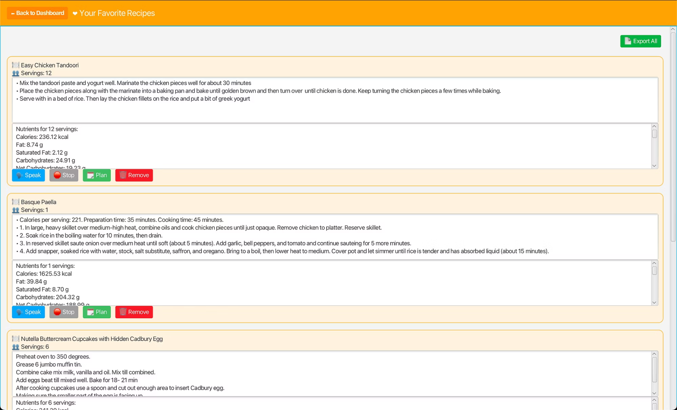
Favorite Recipes

Slide 13
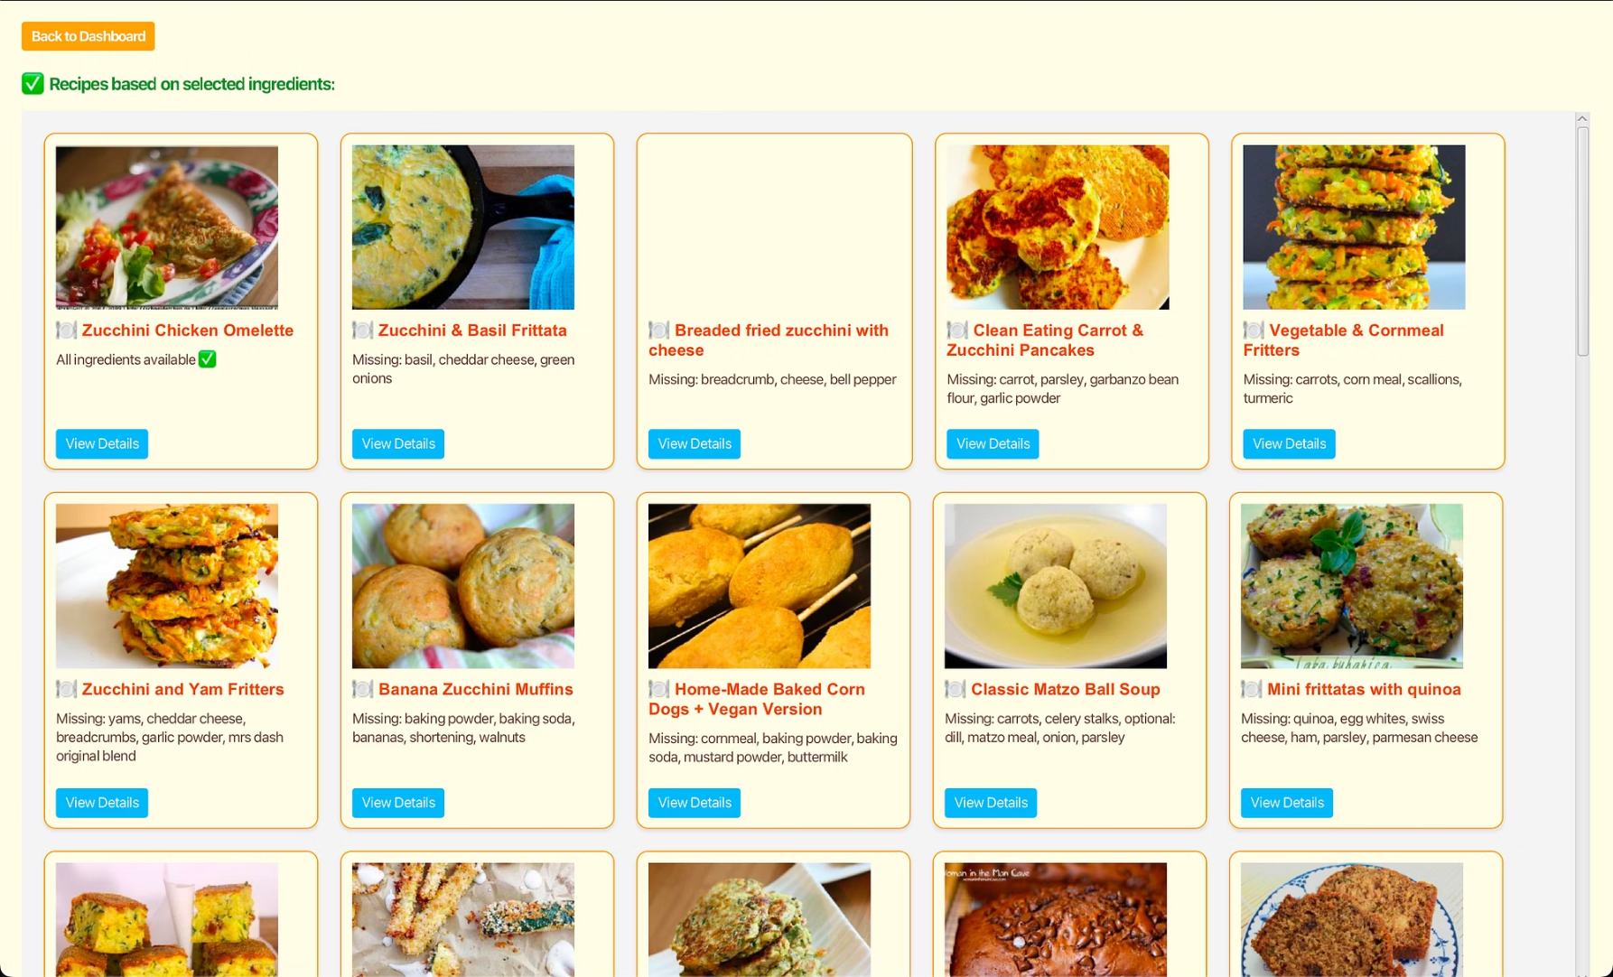
Generate Recipes

Slide 14

Profile

Slide 15
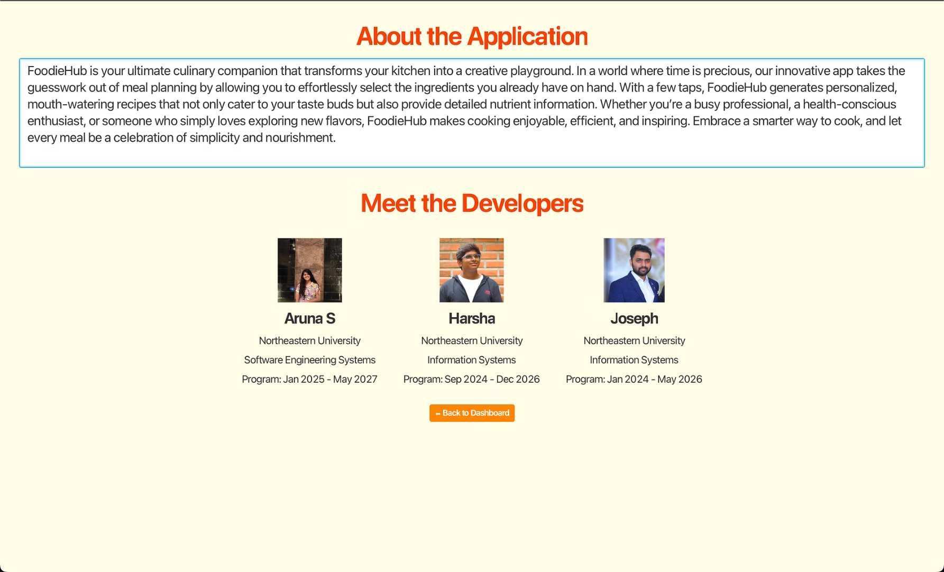
About Us

Slide 16
Discussion(Reflection)
Data Persistence
UI Responsiveness
Image Handling
Implemented JDBC and SQL to reliably store recipe details and user data.
Designed a dynamic interface to ensure smooth handling of diverse content and user interactions.
Addressed challenges in file path conversion and managed instances of missing images to maintain visual integrity.
Key challenges involved ensuring robust data storage and preserving user context across different application states. Iterative development, guided by user feedback, significantly refined application features and usability.

Slide 17
Conclusions and Future Enhancements
Robust System
API Integration
User-Friendly
The application provides a personalized experience, addressing specific user dietary needs and preferences with tailored recipe suggestions.
Local recipe data seamlessly integrates with external suggestions from the Spoonacular API, enriching the recipe options available to users.
A dynamic and responsive user interface, combined with persistent data storage, ensures a smooth and engaging user experience across different application states.
Future enhancements include adding a shopping cart feature for easy grocery management, sorting recipes based on missing ingredients to simplify meal preparation, and implementing meal planning reminders to encourage consistent use. Additionally, vegetarian filters and other dietary options are planned to cater to a wider range of user preferences.

Slide 18
Team Contributions
Joseph
Login, Signup, Favorite Meal, Planned Meal, Recipe Ratings
Aruna
Home, My Recipe, Foodiehub Recipe, Add Recipe
Harsha
Dashboard, Generate Recipe, Profile, AboutUs, Logout

Slide 19

For listening to us.
We appreciate your time and attention. We welcome any questions or feedback you may have.

